Slide 1


<Name>
<Date>

Slide 2

Outline
Executive Summary
Introduction
Methodology
Results
Conclusion
Appendix

Slide 3
Executive Summary
Summary of methodologies
Data Collection and Data Wrangling
Data Analysis and Visualization with SQL
Interactive Visualization and Analysis
Machine Learning Prediction
Summary of all results

Slide 4
Introduction
Project background and context:
We as a data scientist trying to analyze data based on rocket launch companies their cost, successful landing rates and further future possibilities Sending spacecraft to the International Space Station. Starlink, a satellite internet constellation providing satellite Internet access. Sending manned missions to Space. One reason SpaceX can do this is the rocket launches are relatively inexpensive.
Also, how space_x is reusing it rockets for other launches, saving a lots of cost of the companies. Analyzing the data, through various methods like, wrangling, scrapping, visualizing, model building will help us to know more learn more and predict more as a data scientist.
Problems you want to find answers
How the launch sites are build
How the prediction model can predict on the outcome of the landing results.

Slide 5

Section 1

Slide 6
Methodology
Executive Summary
Data collection methodology:
Data was collected using information stored in space_x past url, we retrieved it with request.get() method and json_normalize() menthod.
Perform data wrangling
Finding and replacing null values, getting count of launch sites using values_count method(), identifying various launch sites and there outcomes.
Perform exploratory data analysis (EDA) using visualization and SQL
Perform interactive visual analytics using Folium and Plotly Dash
Perform predictive analysis using classification models
Using the data we can build a data frame for testing, basis which we can split data into test and train. Post which we can evaluate and classify the model.

Slide 7
Data Collection
Describe how data sets were collected.
You need to present your data collection process use key phrases and flowcharts

Slide 8
Data Collection – SpaceX API
Present your data collection with SpaceX REST calls using key phrases and flowcharts
Add the GitHub URL of the completed SpaceX API calls notebook, as an external reference and peer-review purpose
https://github.com/SharmaAnkitt/Final-Capstone-Project/blob/409f7eda2b6c4d0af3bec0441085c5099becde11/Week%201%20-%20Data%20Collection.ipynb

Slide 9
Data Collection - Scraping
Present your web scraping process using key phrases and flowcharts
Add the GitHub URL of the completed web scraping notebook, as an external reference and peer-review purpose
https://github.com/SharmaAnkitt/Final-Capstone-Project.git
Place your flowchart of web scraping here

Slide 10
Data Wrangling
Describe how data were processed
Data was processed using lib like Pandas and Numpy
Data from csv files was loaded to a dataframe
Null values were eliminated using replace.np.nan method
Using Value_count taking up count of various columns like launch sites
https://github.com/SharmaAnkitt/Final-Capstone-Project/blob/c06bc53282700fd77c066c85725bc5fa45b63ecb/Week%201%20-%20Data%20wrangling.ipynb

Slide 11
EDA with Data Visualization
Summarize what charts were plotted and why you used those charts
Scatter – To see the relationship between two variables and predict the outcome
Bar – To check the relationship between two elements
Line – To predict trend based on past data
Add the GitHub URL of your completed EDA with data visualization notebook, as an external reference and peer-review purpose
https://github.com/SharmaAnkitt/Final-Capstone-Project/blob/c06bc53282700fd77c066c85725bc5fa45b63ecb/Week%202%20-%20EDA%20with%20Visualization.ipynb

Slide 12
EDA with SQL
Using bullet point format, summarize the SQL queries you performed
Create Table
Using WHERE keyword to apply conditions
Distinct keyword to view unique values
Limit 5 to restrict the number to resulting records
Add the GitHub URL of your completed EDA with SQL notebook, as an external reference and peer-review purpose
https://github.com/SharmaAnkitt/Final-Capstone-Project/blob/c06bc53282700fd77c066c85725bc5fa45b63ecb/Week%202%20-%20EDA%20with%20SQL.ipynb

Slide 13
Build an Interactive Map with Folium
Summarize what map objects such as markers, circles, lines, etc. you created and added to a folium map
Explain why you added those objects
Add the GitHub URL of your completed interactive map with Folium map, as an external reference and peer-review purpose

Slide 14
Build a Dashboard with Plotly Dash
Summarize what plots/graphs and interactions you have added to a dashboard
Explain why you added those plots and interactions
Add the GitHub URL of your completed Plotly Dash lab, as an external reference and peer-review purpose

Slide 15
Predictive Analysis (Classification)
Summarize how you built, evaluated, improved, and found the best performing classification model
Transforming the data
Splitting the data into test and train
Using Gridsearchcv function, which help hyperparameters tuning by training and evaluating models
Using heatmaps to identify the performance of the model
https://github.com/SharmaAnkitt/Final-Capstone-Project/blob/c06bc53282700fd77c066c85725bc5fa45b63ecb/Week%20-%204%20-%20Machine%20Learning%20Prediction.ipynb

Slide 16
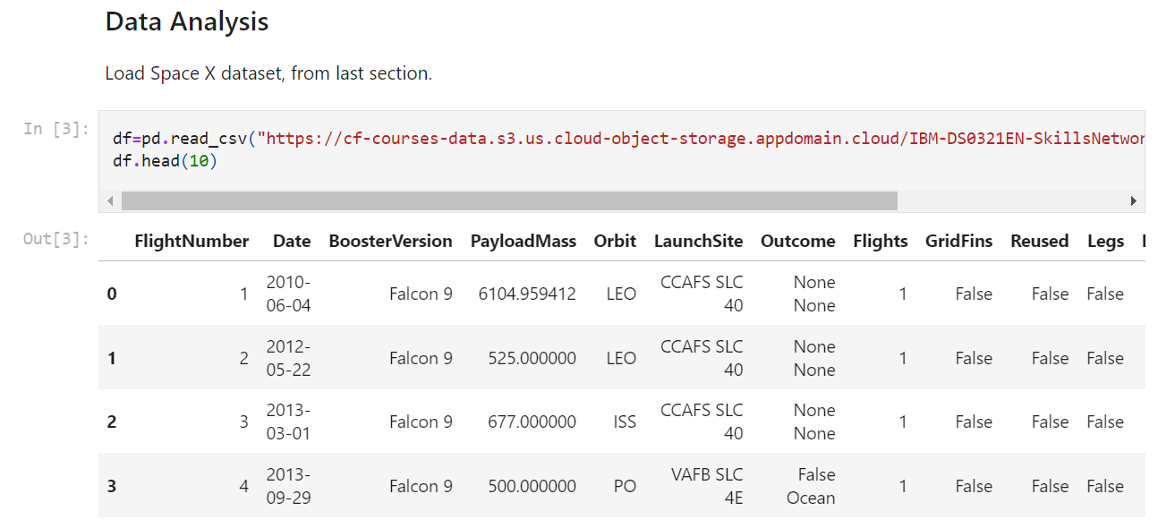
Results
Exploratory data analysis results

Slide 17
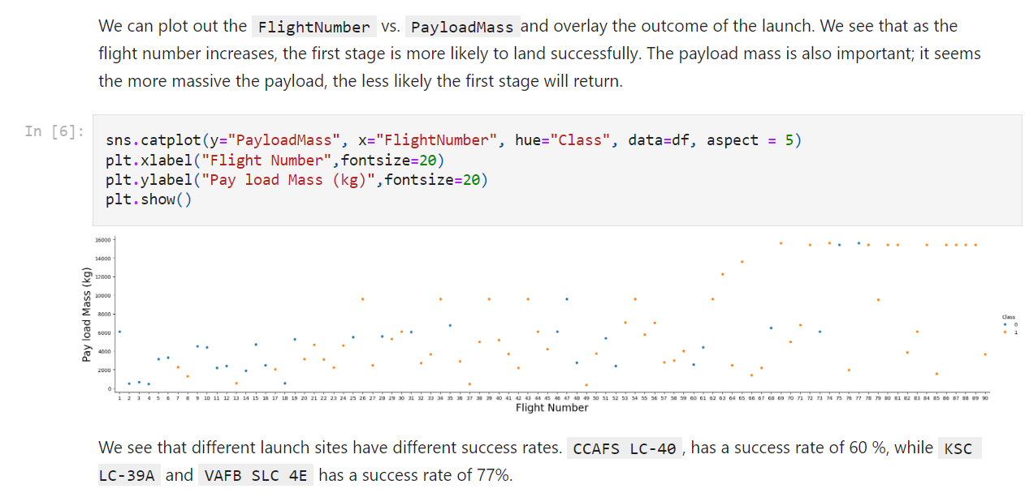
Results
Interactive analytics demo in screenshots

Slide 18
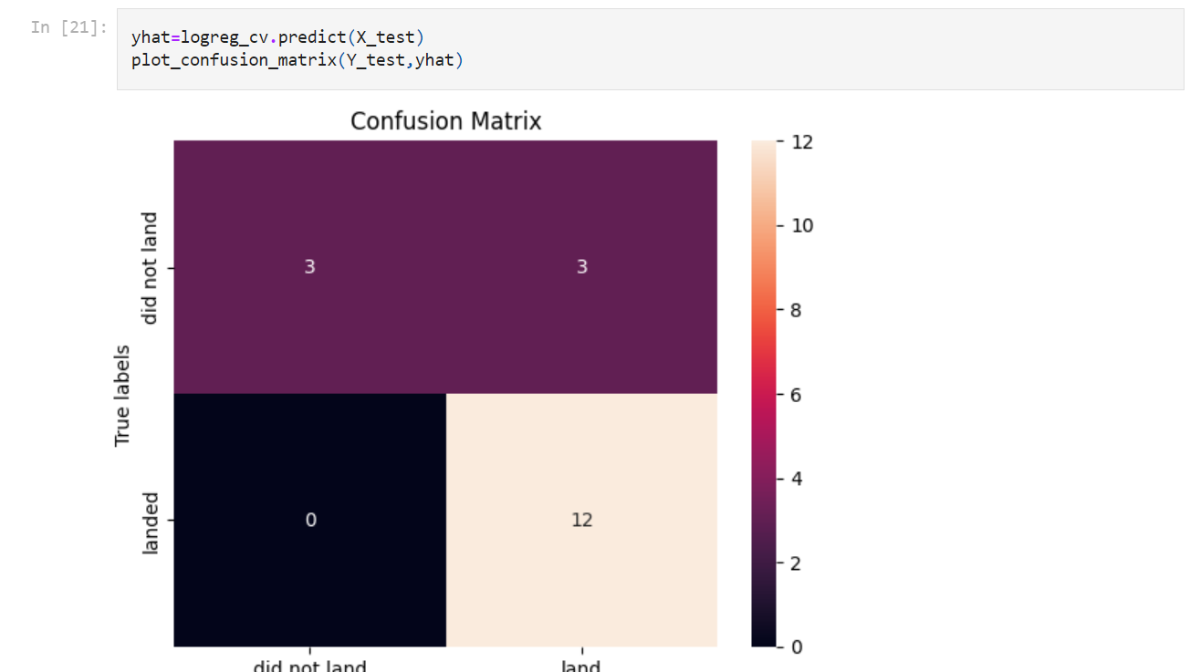
Results
Predictive Analysis

Slide 19

Section 2

Slide 20
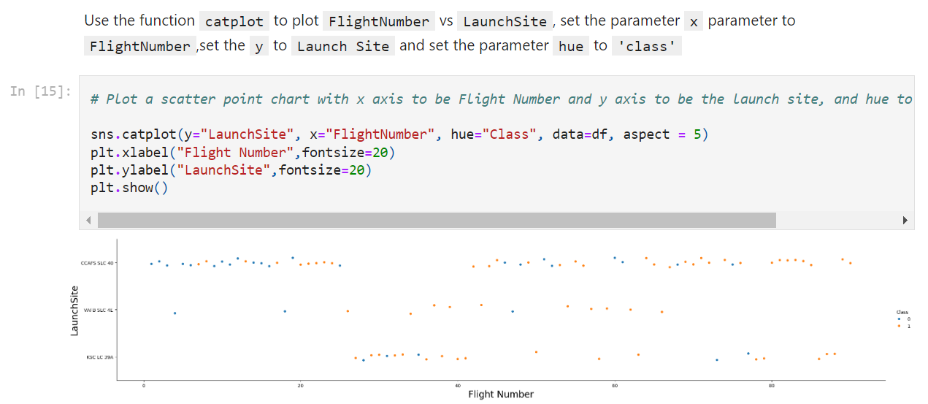
Flight Number vs. Launch Site
Show a scatter plot of Flight Number vs. Launch Site

Slide 21
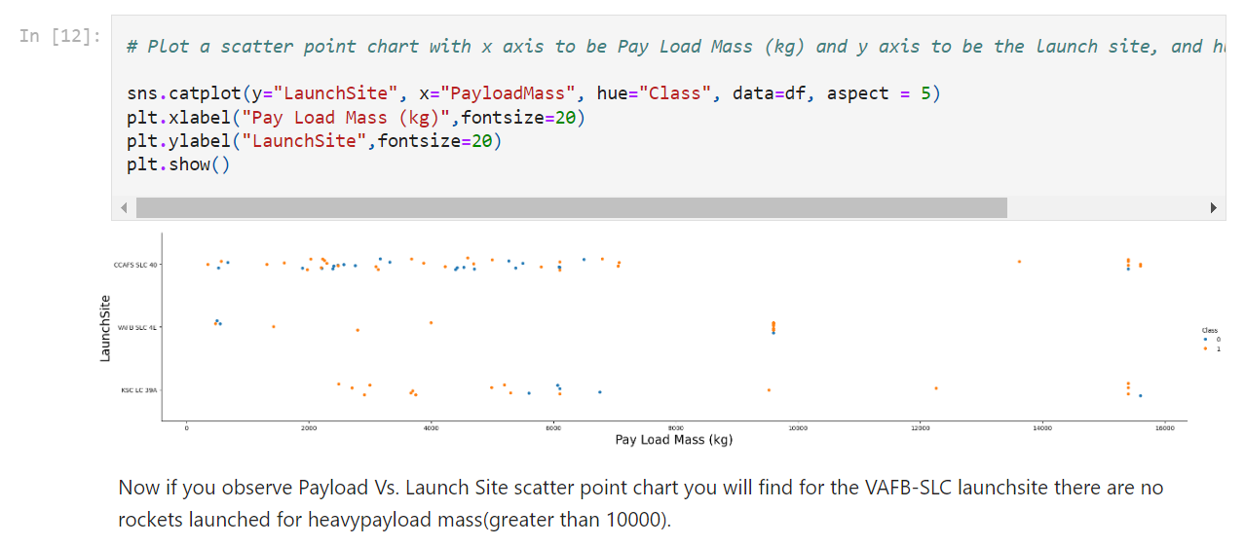
Payload vs. Launch Site
Show a scatter plot of Payload vs. Launch Site

Slide 22
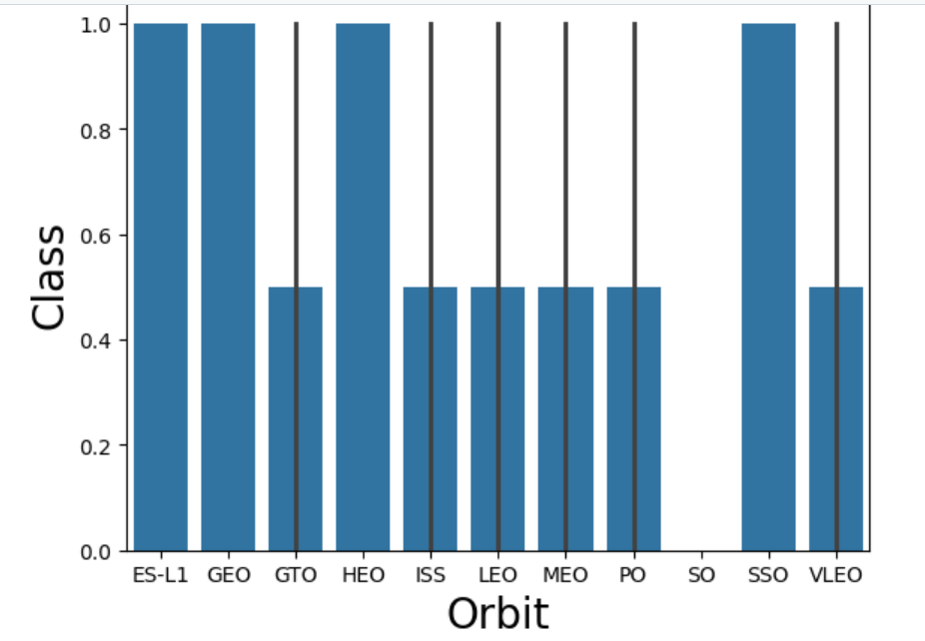
Success Rate vs. Orbit Type
Show a bar chart for the success rate of each orbit type

Slide 23
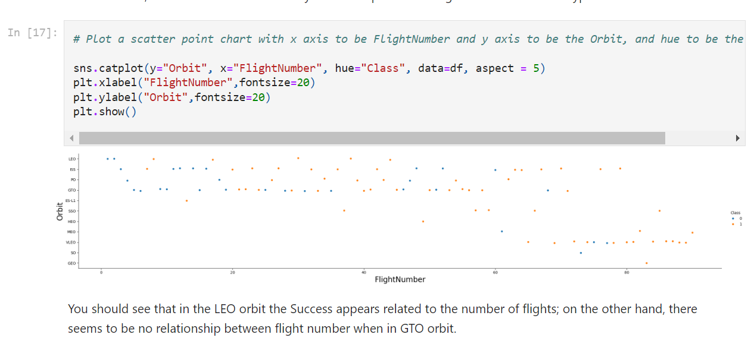
Flight Number vs. Orbit Type
Show a scatter point of Flight number vs. Orbit type

Slide 24
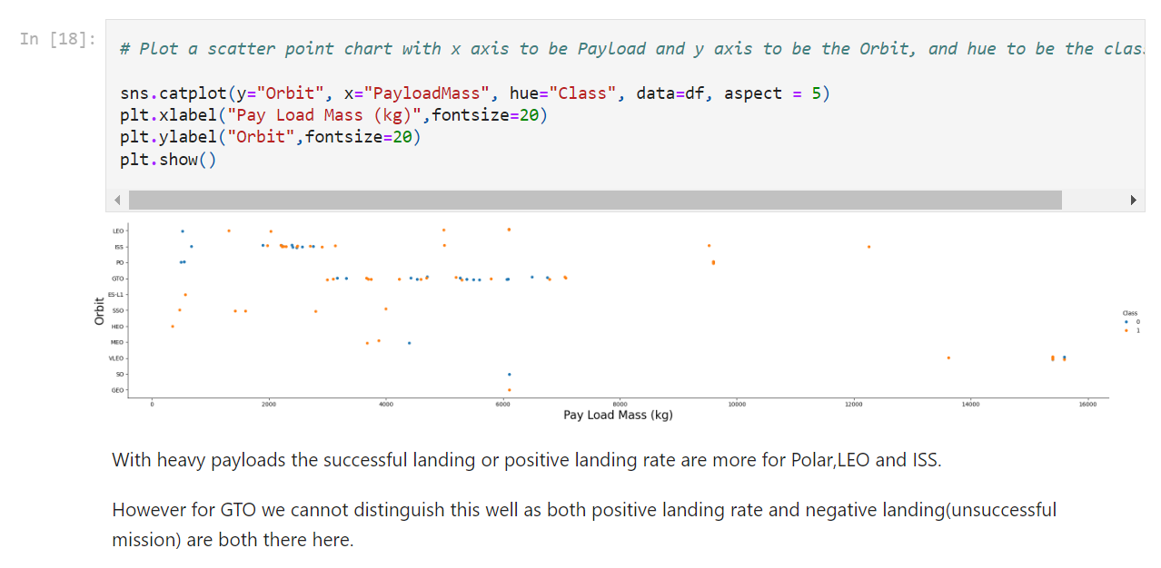
Payload vs. Orbit Type
Show a scatter point of payload vs. orbit type

Slide 25
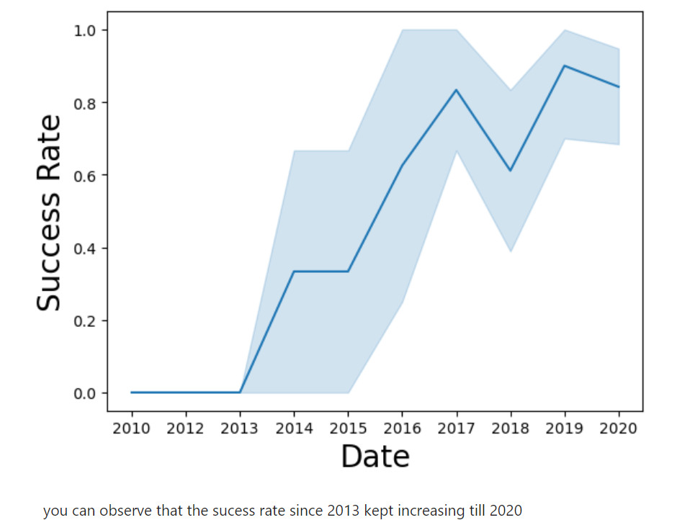
Launch Success Yearly Trend
Show a line chart of yearly average success rate

Slide 26
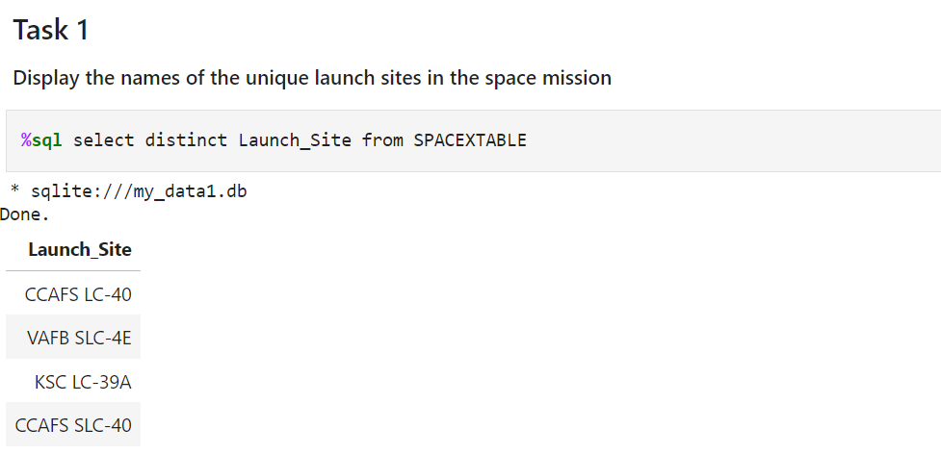
All Launch Site Names
Find the names of the unique launch sites
Present your query result with a short explanation here

Slide 27
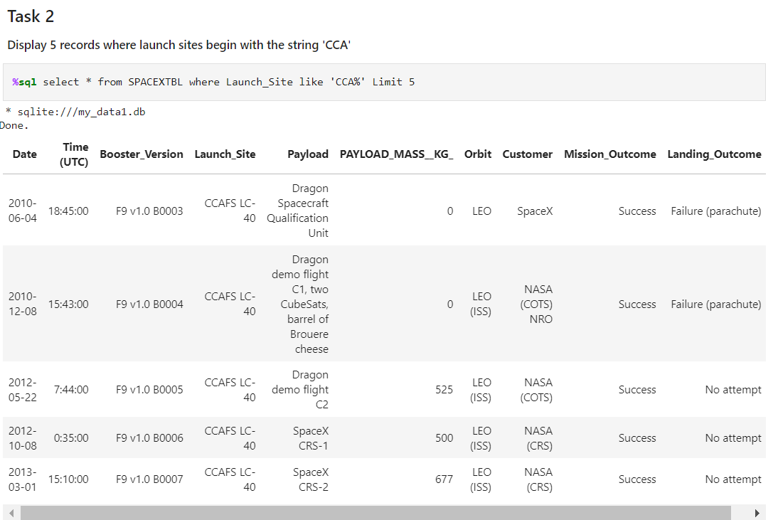
Launch Site Names Begin with 'CCA'
Find 5 records where launch sites begin with `CCA`
Present your query result with a short explanation here

Slide 28
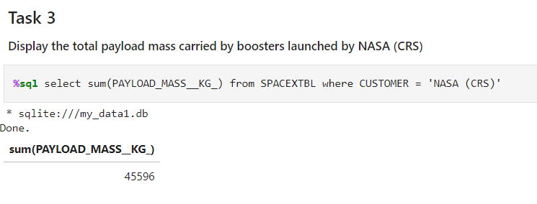
Total Payload Mass
Calculate the total payload carried by boosters from NASA
Present your query result with a short explanation here

Slide 29
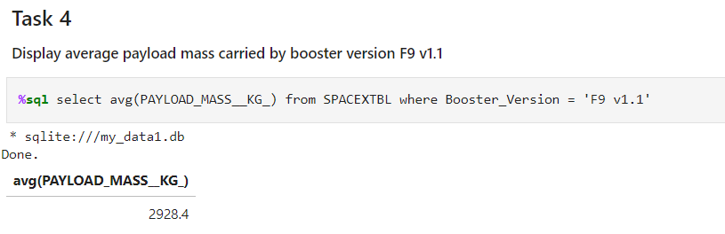
Average Payload Mass by F9 v1.1
Calculate the average payload mass carried by booster version F9 v1.1
Present your query result with a short explanation here

Slide 30
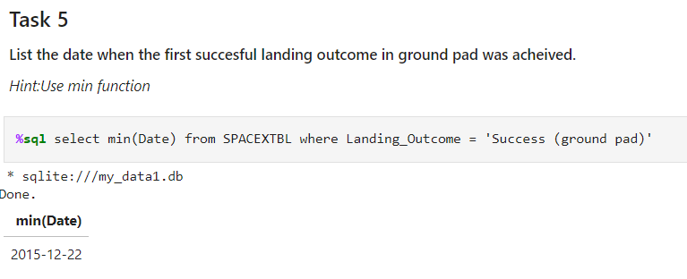
First Successful Ground Landing Date
Find the dates of the first successful landing outcome on ground pad
Present your query result with a short explanation here

Slide 31
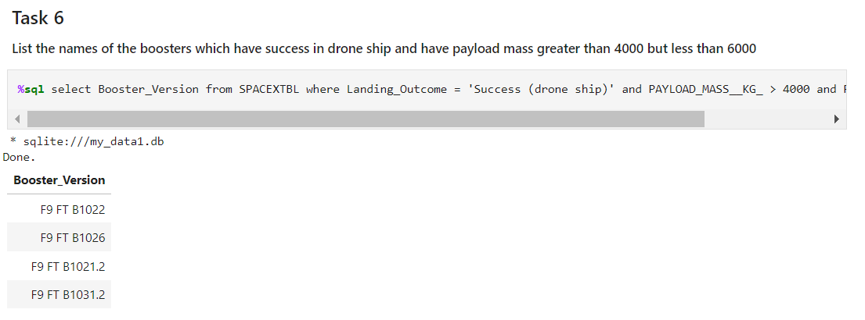
Successful Drone Ship Landing with Payload between 4000 and 6000
List the names of boosters which have successfully landed on drone ship and had payload mass greater than 4000 but less than 6000
Present your query result with a short explanation here

Slide 32
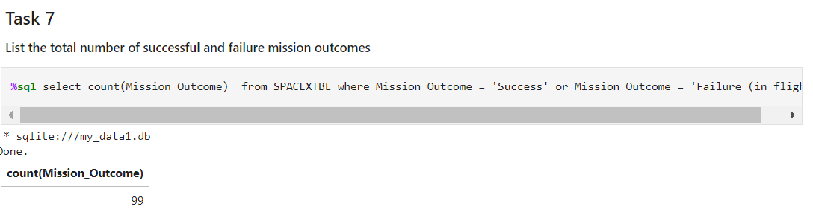
Total Number of Successful and Failure Mission Outcomes
Calculate the total number of successful and failure mission outcomes
Present your query result with a short explanation here

Slide 33
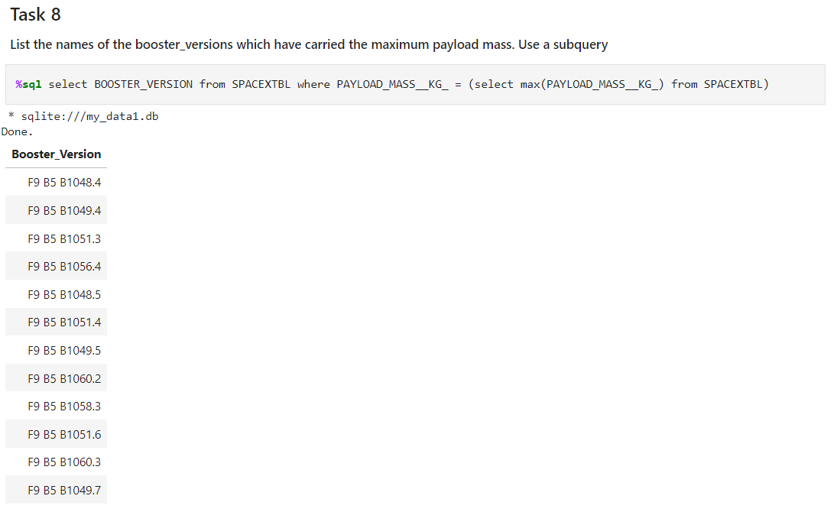
Boosters Carried Maximum Payload
List the names of the booster which have carried the maximum payload mass
Present your query result with a short explanation here

Slide 34
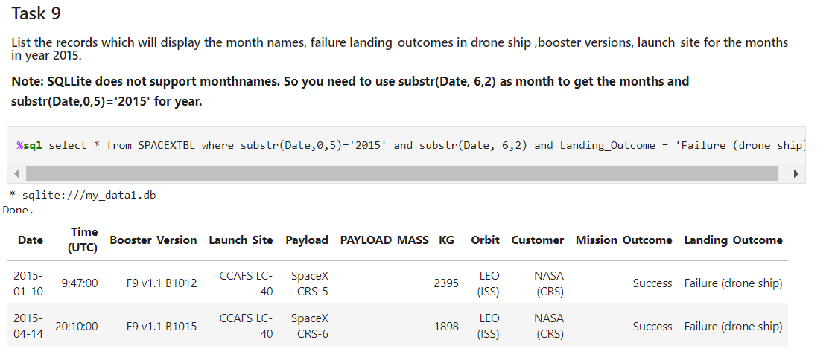
2015 Launch Records
List the failed landing_outcomes in drone ship, their booster versions, and launch site names for in year 2015

Slide 35
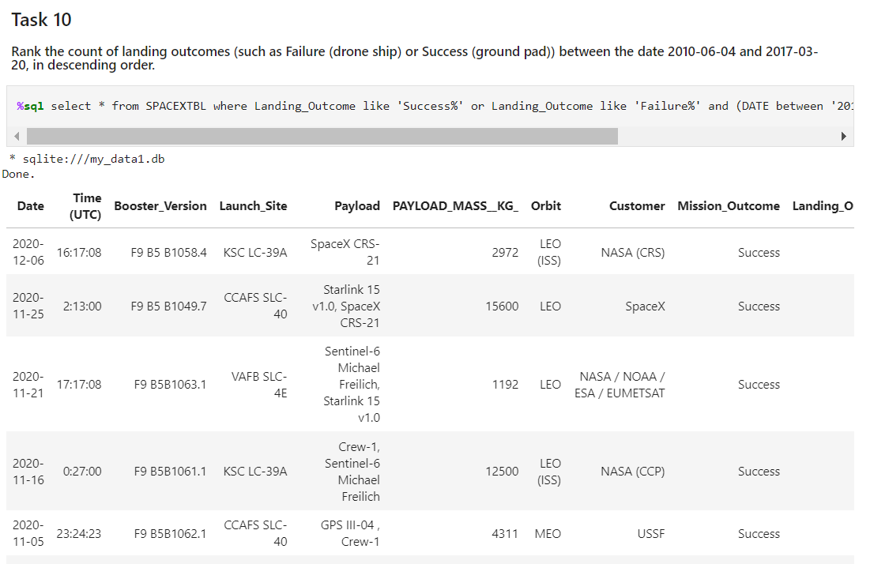
Rank Landing Outcomes Between 2010-06-04 and 2017-03-20
Rank the count of landing outcomes (such as Failure (drone ship) or Success (ground pad)) between the date 2010-06-04 and 2017-03-20, in descending order

Slide 36

Section 3

Slide 37
<Folium Map Screenshot 1>
Replace <Folium map screenshot 1> title with an appropriate title
Explore the generated folium map and make a proper screenshot to include all launch sites’ location markers on a global map
Explain the important elements and findings on the screenshot

Slide 38
<Folium Map Screenshot 2>
Replace <Folium map screenshot 2> title with an appropriate title
Explore the folium map and make a proper screenshot to show the color-labeled launch outcomes on the map
Explain the important elements and findings on the screenshot

Slide 39
<Folium Map Screenshot 3>
Replace <Folium map screenshot 3> title with an appropriate title
Explore the generated folium map and show the screenshot of a selected launch site to its proximities such as railway, highway, coastline, with distance calculated and displayed
Explain the important elements and findings on the screenshot

Slide 40

Section 4

Slide 41
<Dashboard Screenshot 1>
Replace <Dashboard screenshot 1> title with an appropriate title
Show the screenshot of launch success count for all sites, in a piechart
Explain the important elements and findings on the screenshot

Slide 42
<Dashboard Screenshot 2>
Replace <Dashboard screenshot 2> title with an appropriate title
Show the screenshot of the piechart for the launch site with highest launch success ratio
Explain the important elements and findings on the screenshot

Slide 43
<Dashboard Screenshot 3>
Replace <Dashboard screenshot 3> title with an appropriate title
Show screenshots of Payload vs. Launch Outcome scatter plot for all sites, with different payload selected in the range slider
Explain the important elements and findings on the screenshot, such as which payload range or booster version have the largest success rate, etc.

Slide 44

Section 5

Slide 45
Classification Accuracy
Visualize the built model accuracy for all built classification models, in a bar chart
Find which model has the highest classification accuracy

Slide 46
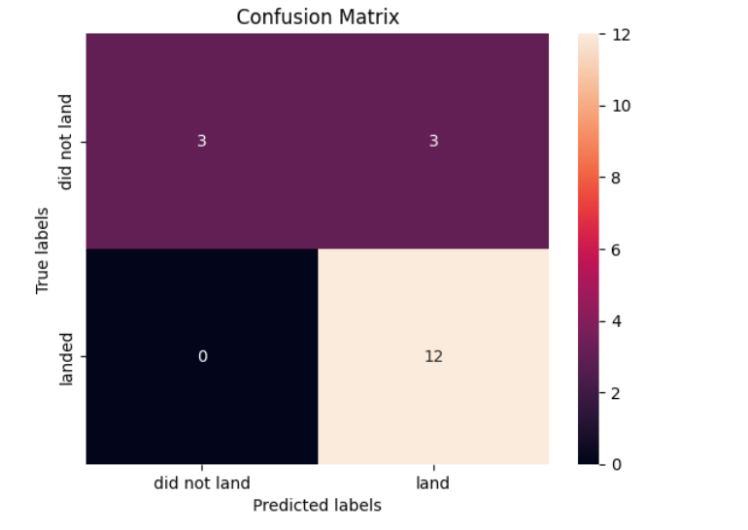
Confusion Matrix
Show the confusion matrix of the best performing model with an explanation

Slide 47
Conclusions
Using the Data collection lab, we learned ways how to import, clean and transform the data. Post which we were able to identify about space_x launch programs
Data Wrangling lab helped us to find out about the success and failure rates of the launches along with the possibilities of landing or crashing
EDA with SQL and Visualization helps us to analyze the the patterns and relationship between two variables.
Predictive ML models helps us to identify how we can compare various variables on our model and predict the outcome and makes changes accordingly.

Slide 48
Appendix
Jupyter Lab
Lib: Pandas, Numpy, Ploty, Matplotlib
SQL
Machine Learning Models
Request
Charts

Slide 49


